Slide 1
React.JS
Lecture 24
React Misc. Concepts

Slide 2
Road Map
JSX & Fragments
Map Function
Passing functions to child
Conditional Rendering
Props.children
Forms
Controlled Forms
Uncontrolled Forms
Using Hooks
React-Redux Forms
FormIk

Slide 3
JSX
JSX is a templating language that looks VERY similar to HTML.
This allows you to write templates for your components in a way that’s very comfortable to developers already familiar with HTML, but there are a few extra things that it provides.
First, you can embed any javascript inside of a JSX template by wrapping it in curly braces (these: {}).
Second, some words are special and reserved, such as class, so there are JSX-specific properties / attributes/etc you need to use (such as className).
In addition, React components must only return a SINGLE JSX node at its root, so it’s very common to wrap up your components into a single div that might have multiple children underneath it.

Slide 4
Fragments
A common pattern in React is for a component to return multiple elements. Fragments let you group a list of children without adding extra nodes to the DOM.
render() {
return (
<React.Fragment>
<ChildA />
<ChildB />
<ChildC />
</React.Fragment>
);
}

Slide 5
Map Function Usage
Map operation is “loop over the array and call a function for each element in that array, storing the results in a new array”.
“Map” each item in the array to a special anonymous function that just returns a functionality.
There is a “key” in it.
This is for React to know which element to modify/ remove/ etc when one of the elements in your list changes, it has to be able to uniquely identify which element it is.

Slide 6
Map Function
Let’s look at the implementation of Map Function.
renderGreetings() {
return this.state.greetings.map(name => (
<HelloWorld key={name} name={name}/>
));
}
render() {
return (
<div>
{this.renderGreetings()}
</div>
);
} This will dynamically load components. Greetings is an array

Slide 7
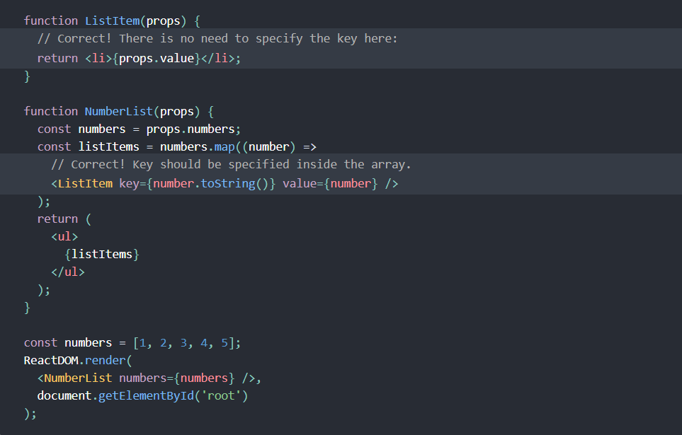

Slide 8
Passing Functions Down To Child Components
By creating the function inside of the parent and passing it down to the child via props!
Inside of parent, we’ll call our function addGreeting, and it needs to be bind inside constructor:
this.addGreeting = this.addGreeting.bind(this);
we’re going to add the addGreeting function itself.
addGreeting(newName) {
this.setState({ greetings: [...this.state.greetings, newName] });
}//concatenation of new value to array
render() {
return (
<div className="HelloWorldList">
<AddGreeter addGreeting={this.addGreeting} />
{this.renderGreetings()}
</div>
);}

Slide 9
Passing Functions Down To Child Components
this.setState({ greetings: [...this.state.greetings, newName] });
We have a new ES2015 feature here, which is an array concatenation shortcut.
This says “the start of the array should remain this.state.greetings, but I also want you to add newName onto the end of the array.
This should return a new modified copy of the array but not change the original.”

Slide 10
Conditional Rendering
In React, you can create distinct components that encapsulate behavior you need.
Then, you can render only some of them, depending on the state of your application.
Conditional rendering in React works the same way conditions work in JavaScript.
Use JavaScript operators like if.
You may embed any expressions in JSX by wrapping them in curly braces.
This includes the JavaScript logical && operator.

Slide 11
Example
function UserGreeting(props) {
return <h1>Welcome back!</h1>;
}
function GuestGreeting(props) {
return <h1>Please sign up.</h1>;
}
function Greeting(props) {
const isLoggedIn = props.isLoggedIn;
if (isLoggedIn) {
return <UserGreeting />;
}
return <GuestGreeting />;
}

Slide 12
Inline condition?true:false;
render() {
const isLoggedIn = this.state.isLoggedIn;
return (
<div>
{isLoggedIn
? <LogoutButton onClick={this.handleLogoutClick} />
: <LoginButton onClick={this.handleLoginClick} />
}
</div>
);
}

Slide 13
Use of Props.children
Some components don’t know their children ahead of time.
This is especially common for components like Sidebar or Dialog that represent generic “boxes”.
Such components use the special children prop to pass children elements directly into their output:
function FancyBorder(props) {
return (
<div className={'FancyBorder FancyBorder-' + props.color}>
{props.children}
</div>
);
}

Slide 14
Calling component
Anything inside the <FancyBorder> JSX tag gets passed into the FancyBorder component as a children prop.
Since FancyBorder renders {props.children} inside a <div>, the passed elements appear in the final output.
function WelcomeDialog() {
return (
<FancyBorder color="blue">
<h1 className="Dialog-title">
Welcome
</h1>
<p className="Dialog-message">
Thank you for visiting our spacecraft!
</p>
</FancyBorder>
);
}

